Slide 1

WORKING WITH FARMERS AND LANDOWNERS IN NY TO RESTORE BOG TURTLE HABITAT
NEW YORK
ELIZABETH MARKS, BIOLOGIST February 2022
Notes:
GO TO VIEW > MASTER > SLIDE MASTER TO EDIT THE IMAGES ON THE TITLE AND DIVIDER SLIDES
RIGHT CLICK ON THE INDIVIDUAL IMAGES TO CHANGE THE IMAGE

Slide 2
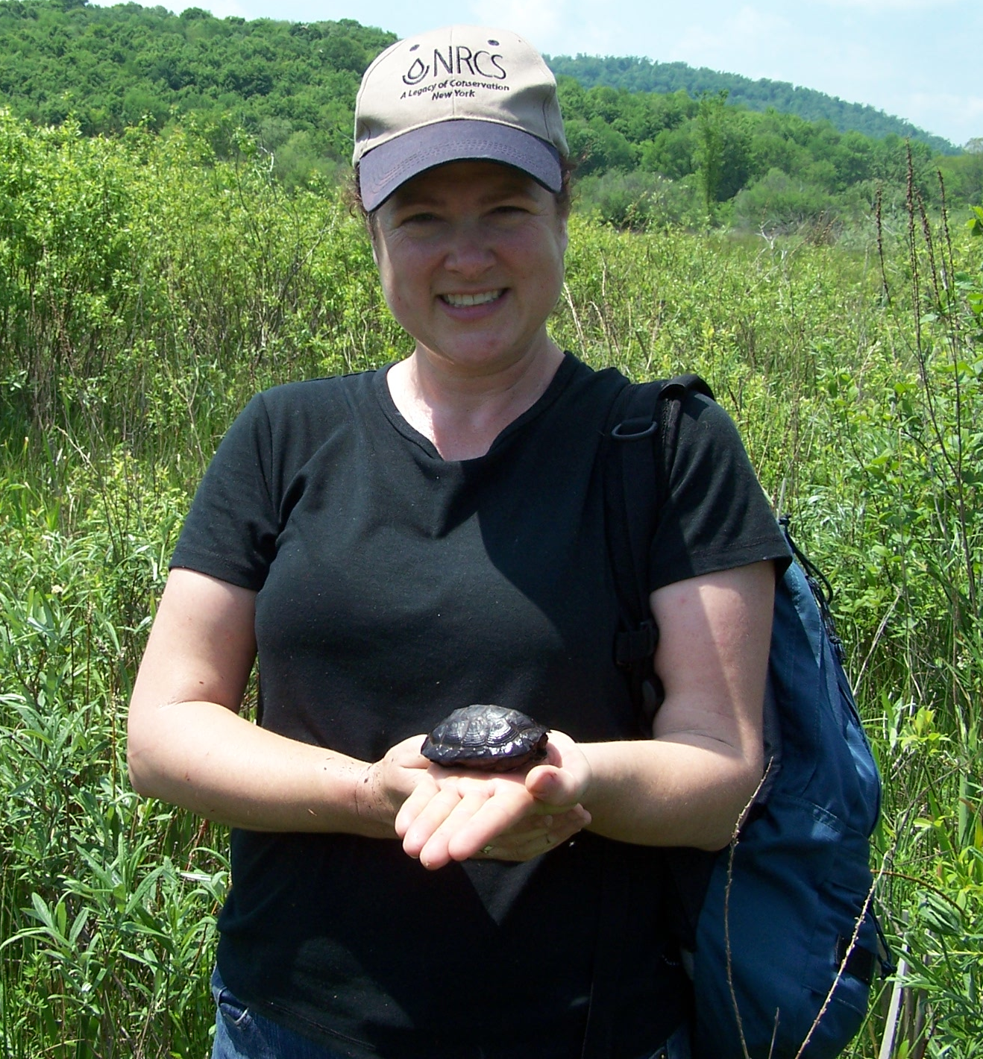
Bog Turtle/Wetland Reserve Program in NY
Began in 2004.
35 projects to date totaling over 500 acres.
18 currently managed projects.
New sites being enrolled yearly.
Receive assistance from Jason Tesauro.

Slide 3
USDA NRCS Funding
Past and current projects funded under:
Wetland Restoration Program
Agriculture Conservation Easement Program
EQIP Habitat
WRP and ACEP also pay for easements.
WRP 10 Year Restoration Cost Share Agreements and EQIP Habitat pays for restoration only.
Have partnered with USFWS Partners for Wildlife and NYS DEC.

Slide 4
Bog Turtle Restoration Projects
Restoration Includes:
Removal of overstory shrubs and trees in wetland.
Fencing of wetland and some upland – ideally adjacent to other upland pastures.
Restoration grazing.
Very limited use of herbicides (only where grazing is impractical or impossible).
Work is done in accordance with USFWS Biological Opinion.
Notes:
To increase plant diversity in wetlands that are dominated with monotypic vegetation (mainly reed canary grass and Phragmites and to a lesser degree cattails, lake sedge) and to remove overstory in a sustainable way.

Slide 5
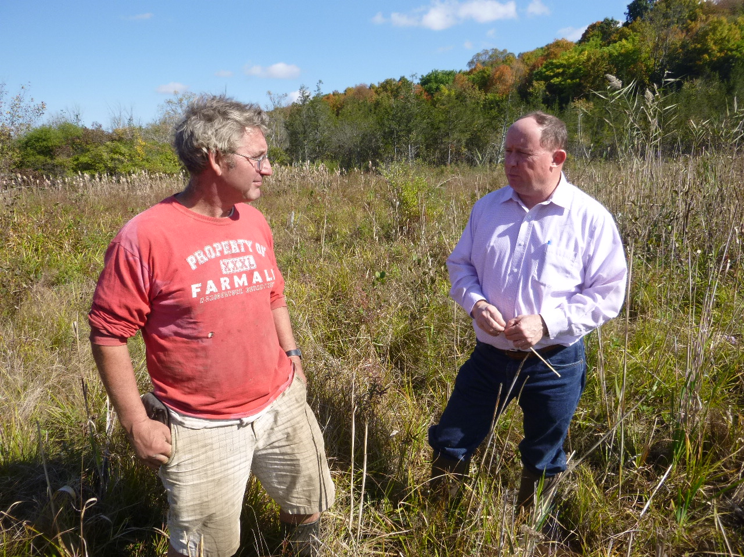
Why Do Landowners Participate?
Bog turtles are cool!
$$ for conservation easements.
Pastures can be “reclaimed.”

Slide 6
Restoration Grazing – Components
2 acres for every 1 animal unit.
No feeding in the easement area.
No soil amendments.
Nesting areas fenced out (can be grazed outside of nesting season).

Slide 7
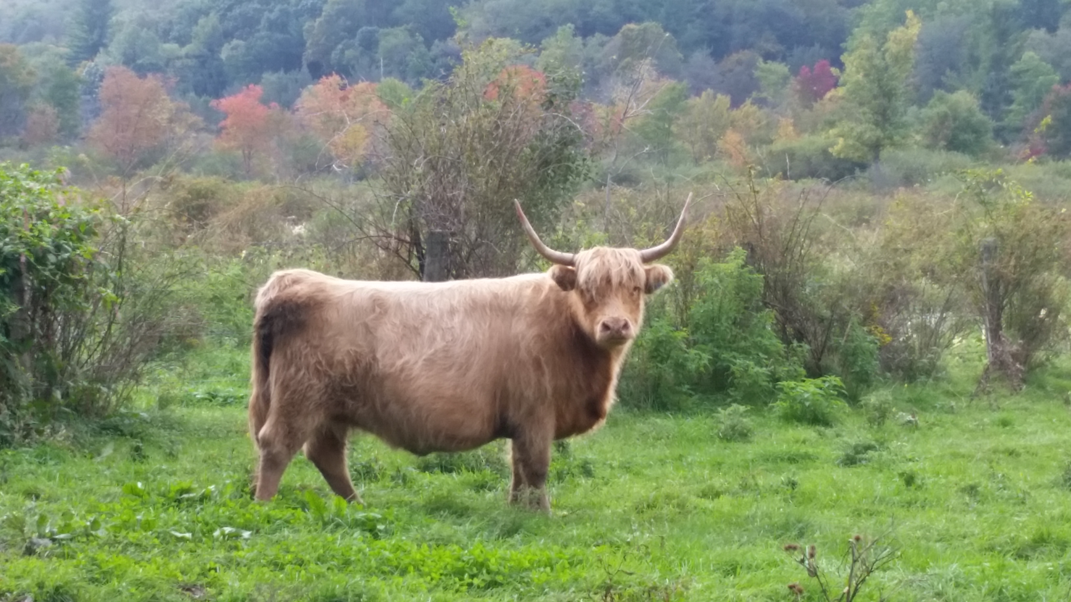
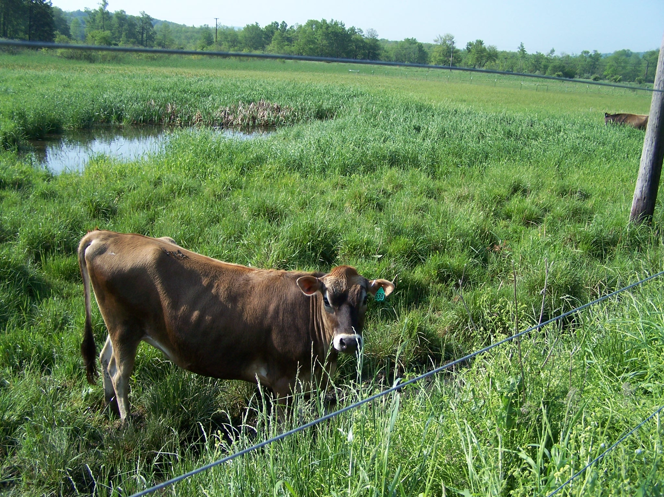
What is the Most Effective Breed or Type of Livestock?
Whatever the farmer has and will stay within the wetland!

Slide 8
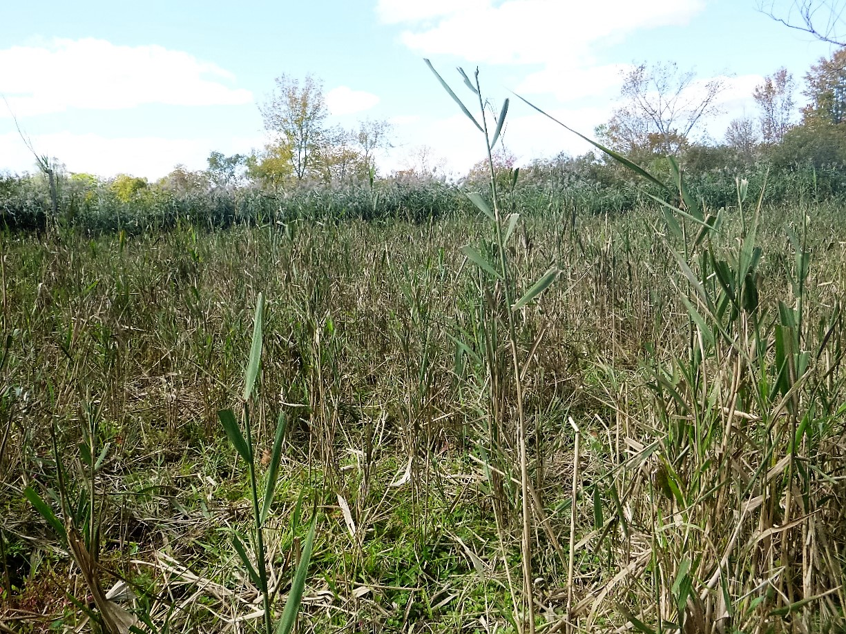

Slide 9
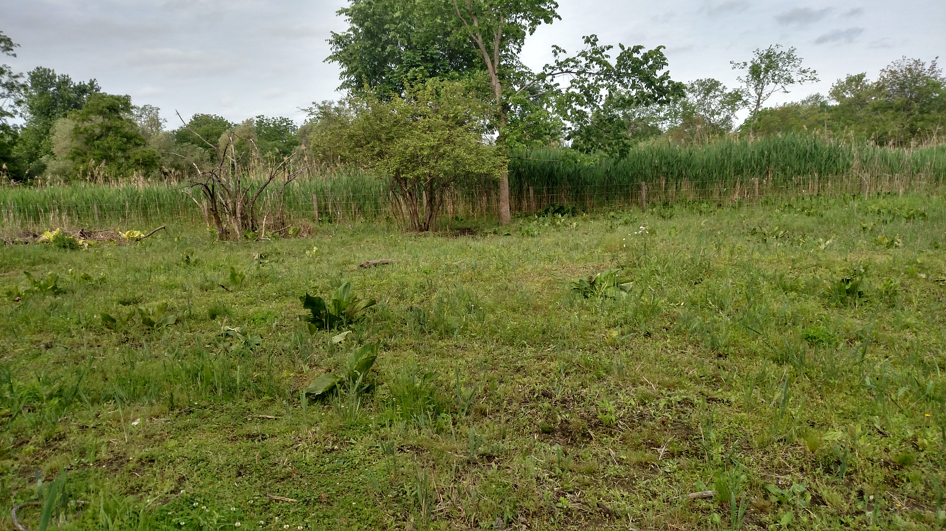

Slide 10
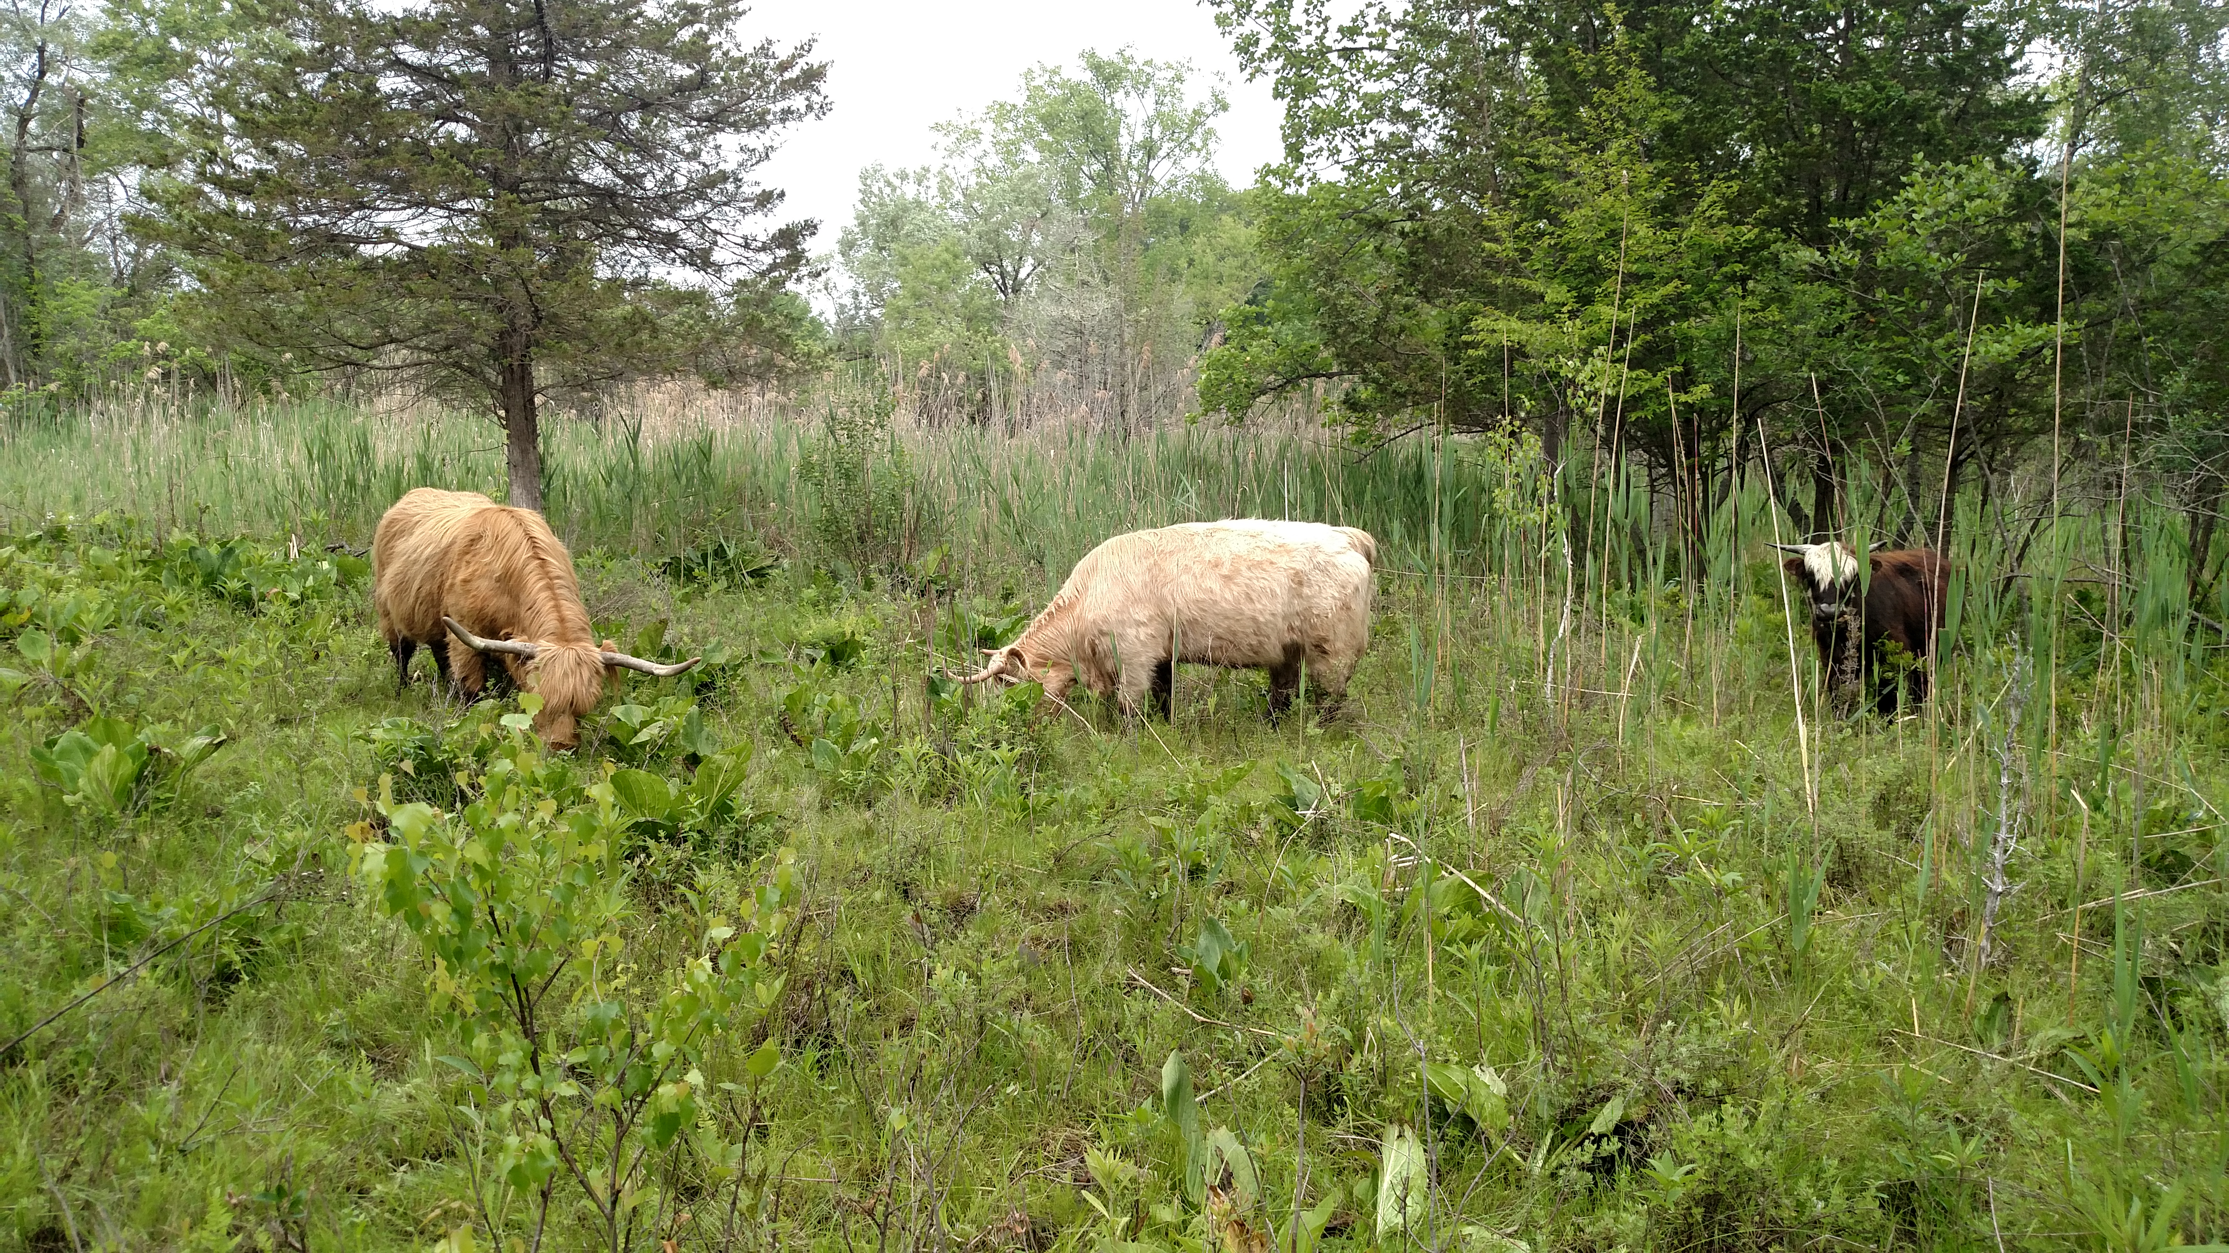

Slide 11
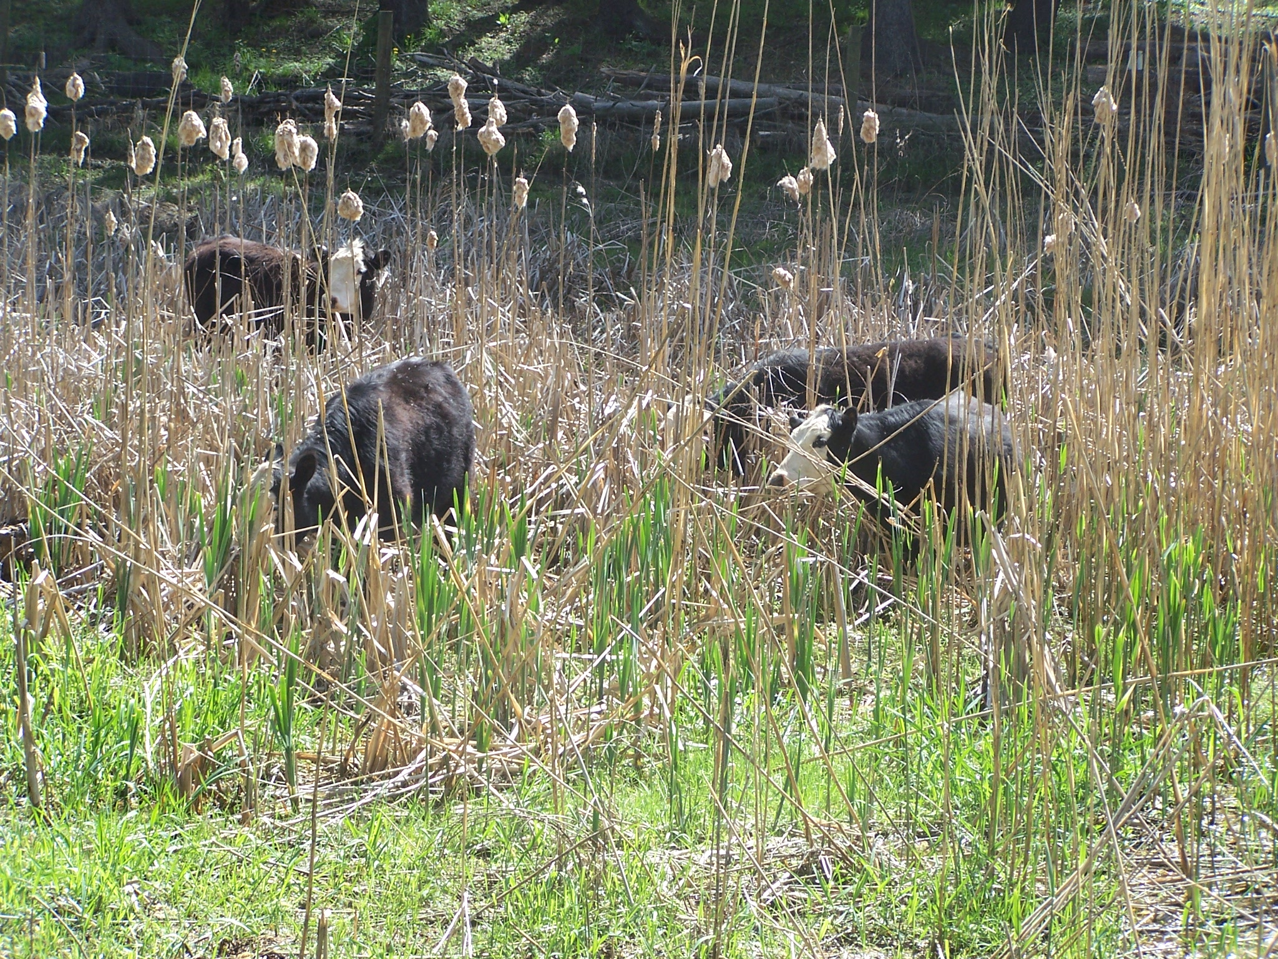
Results – Dramatic Increase in Native Plant Diversity

Slide 12
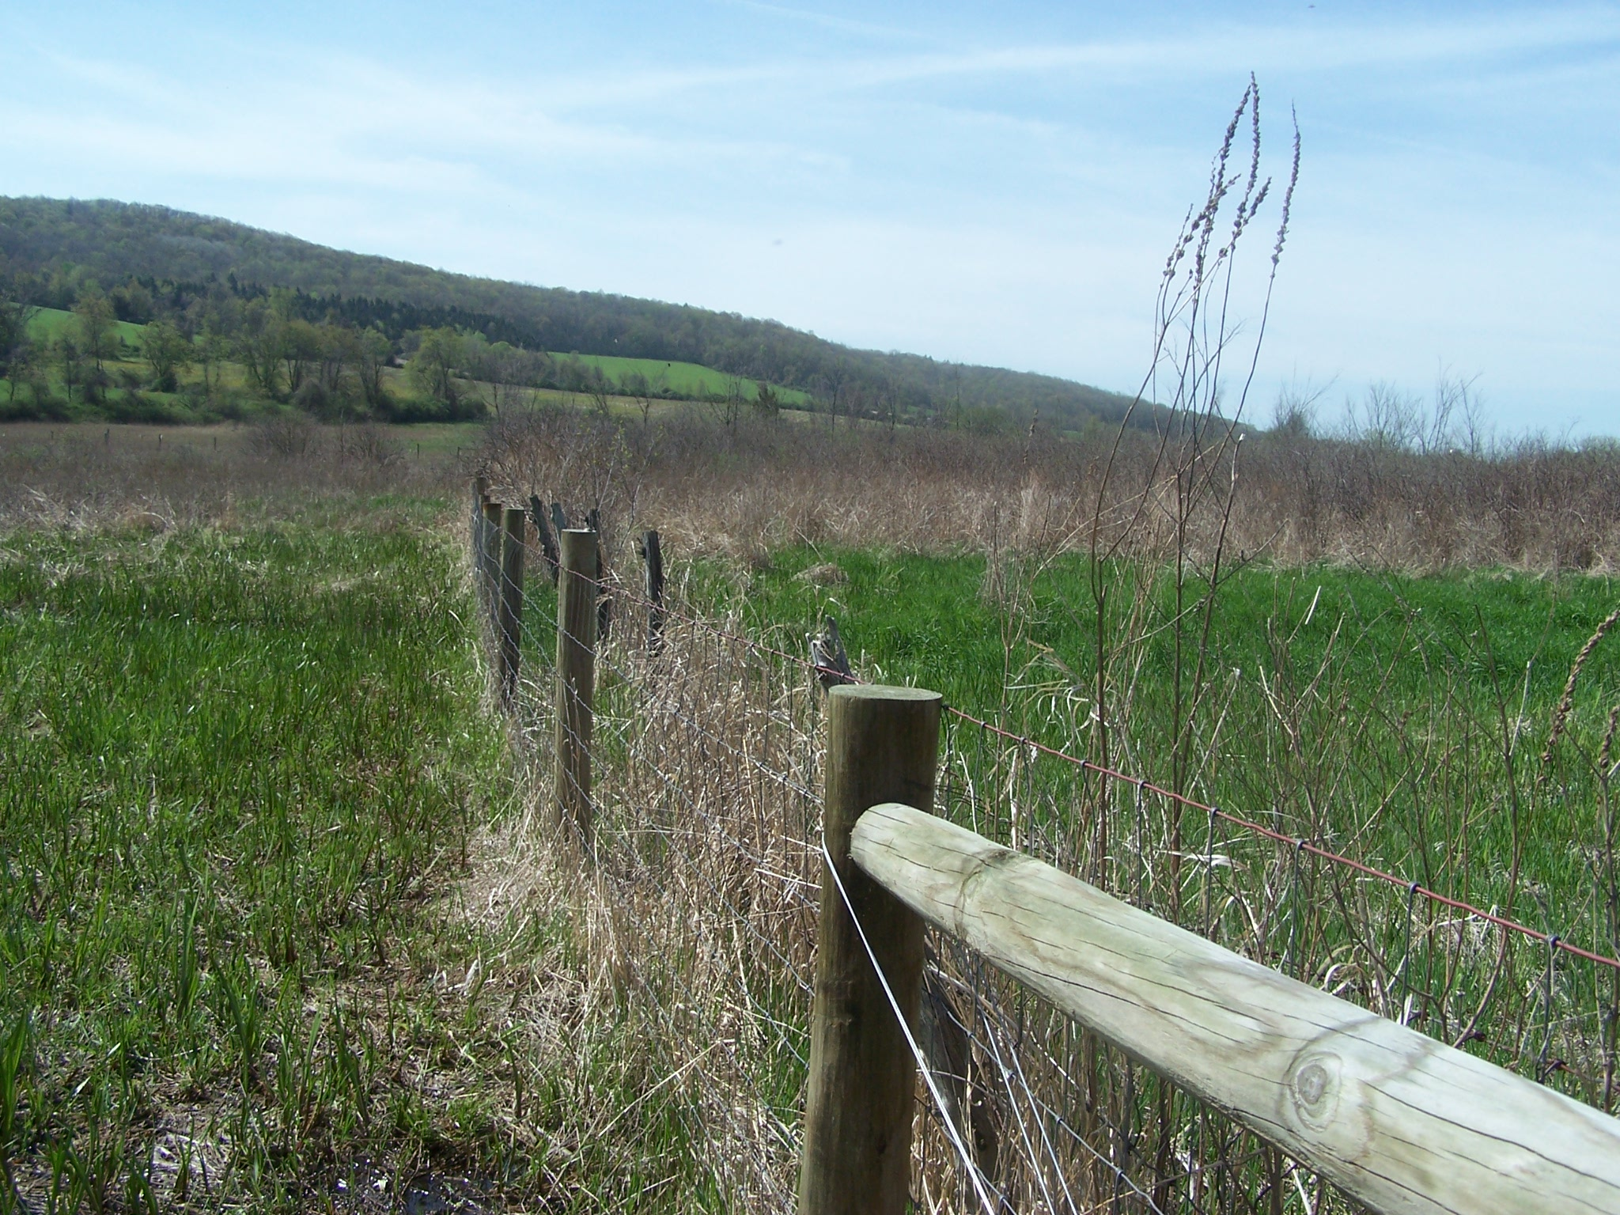

Slide 13
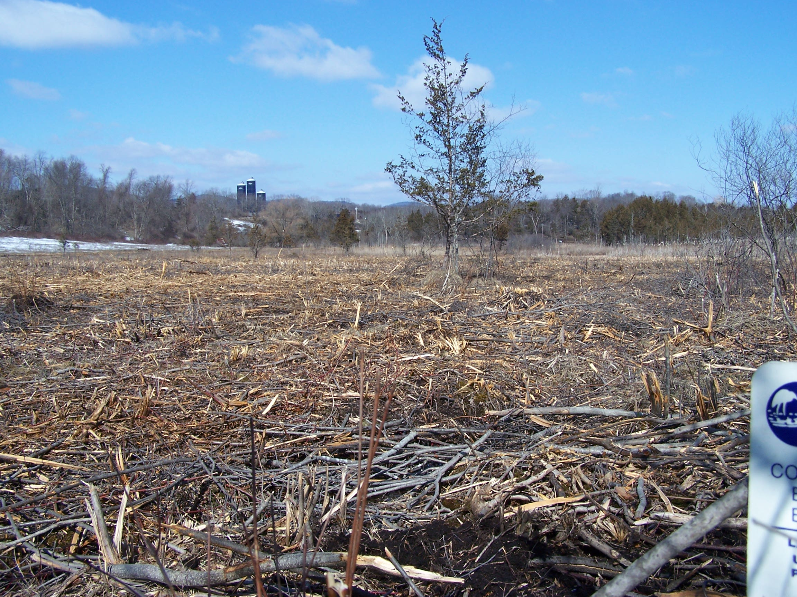
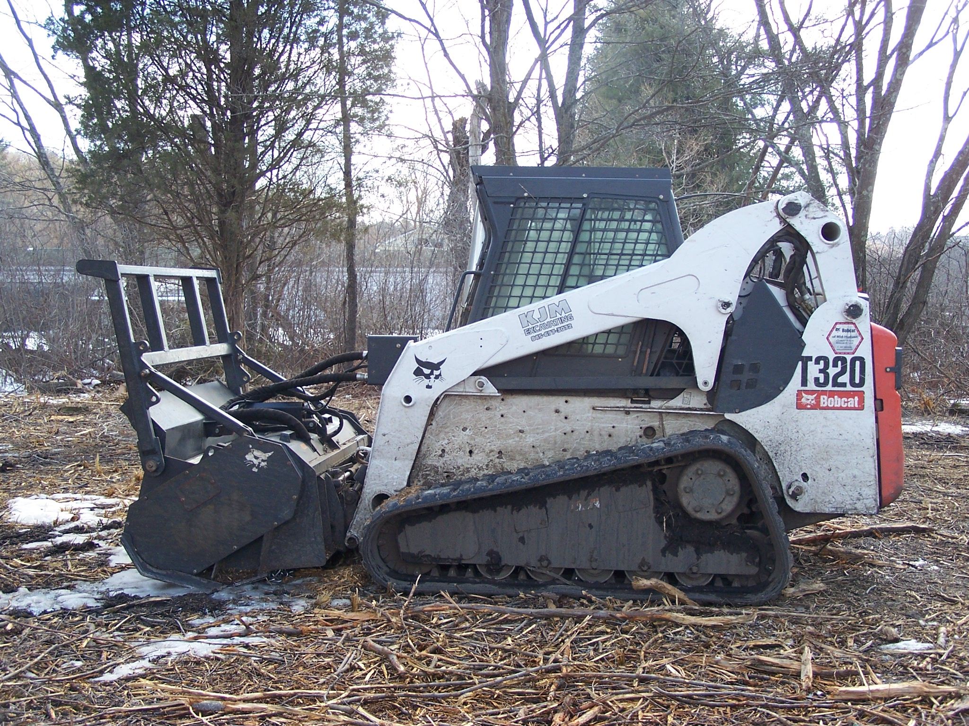

Slide 14
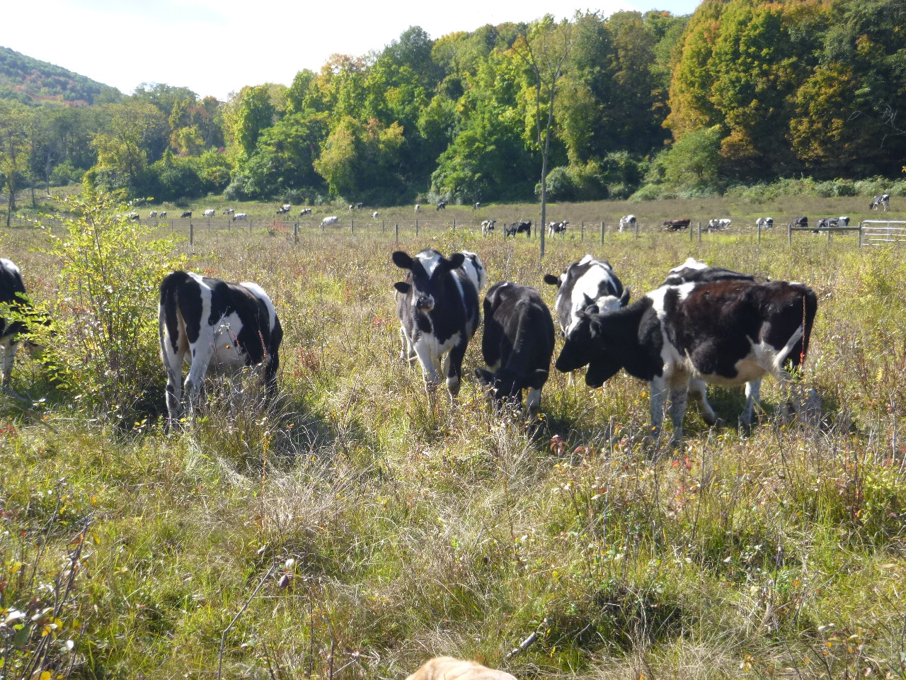
Notes:
Background is an upland pasture outside of the easement area. Foreground is a picture of cows in a 20 acre pasture (were very curious). While we were there with our state conservationist, a cow took a big bite of lake sedge while we were out there.

Slide 15
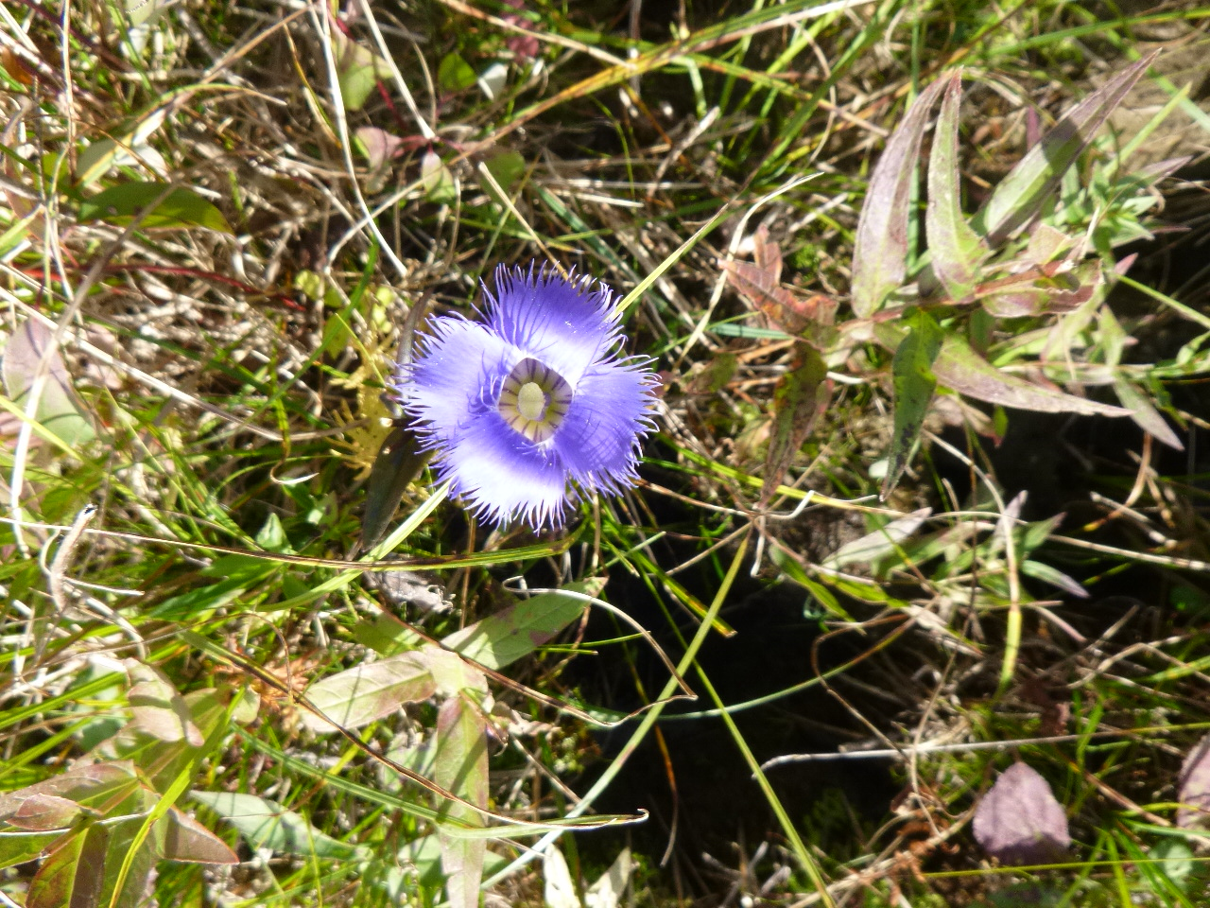
Notes:
Fringed gentian

Slide 16
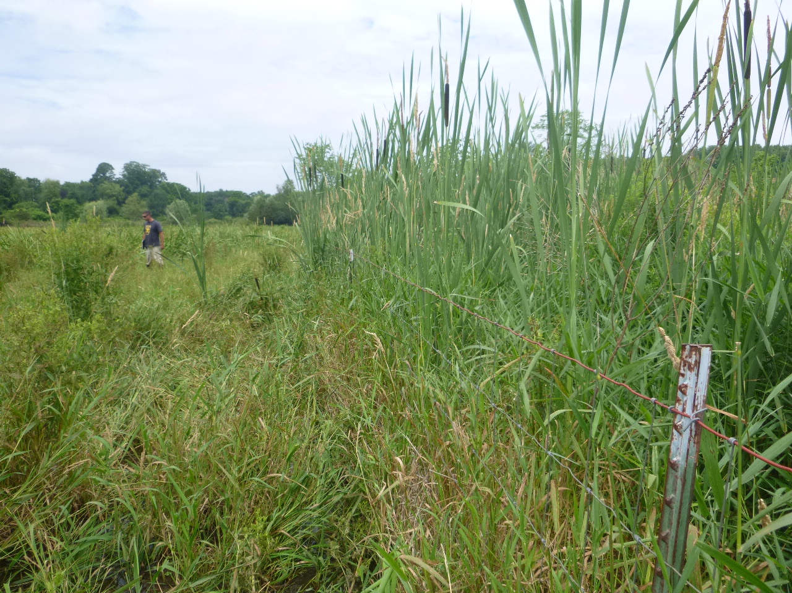
Results

Slide 17
Keys to Success
Target areas that were historically grazed and have become unsuitable.
Low stocking rate.
Graze early – 3-4 weeks before grazing other pastures
  Plants coming out of dormancy are at their weakest (also the most tender and juicy)
Monitor vegetation heights throughout the summer – remove animals if necessary in mid summer.
Graze late – Remove standing dead forage.
Turtle monitoring using the regional protocols (DEC and volunteers)
Contact with farmer at least 2-3 times over the growing season.

Slide 18
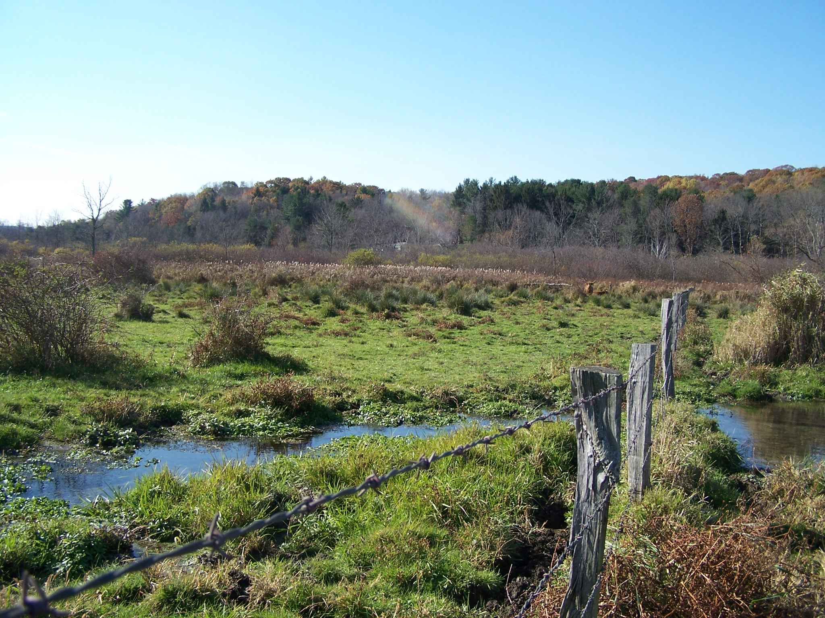
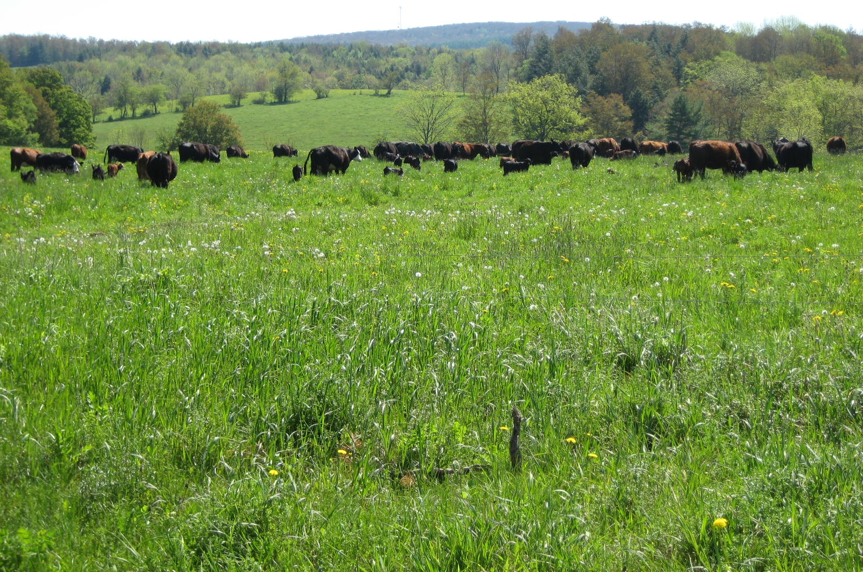

Slide 19
Questions?
Elizabeth Marks
USDA Natural Resources Conservation Service
Area Biologist, New York
(518) 267-3310
elizabeth.marks@ny.usda.gov

